Slide 1

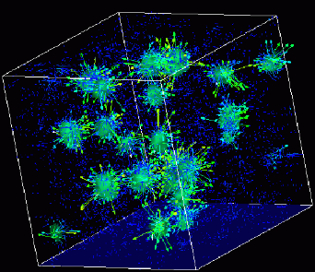
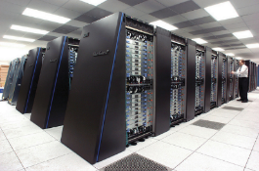
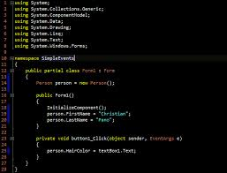
Advanced
Scientific Computing
(SciComp 201)
Session 11
Binary Encoding, Recursive Search with Backtracking

Slide 2
Session Goals
Learn the rules for the Scramble Squares puzzle
Formulate research questions to analyze the puzzle
Consider how to encode the puzzle pieces
Develop a method to describe a puzzle solution
Understand the algorithm to check for a valid layout
Appreciate how recursion can be used to solve the puzzle

Slide 3
Scramble Squares
9 tiles in a 3 x 3 matrix
Each tile can be rotated in 4 different positions
Inside edge of adjacent tiles must complete a full image (a complimentary “match”)
Edges around outside of entire matrix do not need to match the other side
There may be multiple solutions (layouts) but there is always at least one

Slide 4
Frame of Reference
60 seconds in one minute
60 minutes in one hour
24 hours in one day
365 days in one year
60 x 60 x 24 x 365 = ~ 32M
Remember this frame of reference:
There are only 32 million seconds in a year

Slide 5
Frame of Reference
9 scramble squares
4 possible rotations per square
9 x 4 = 36 possible “squares”
36 permute 9 = ~ 34 trillion layouts
Testing one layout / sec = 1M years to test them all
Remember this frame of reference:
There are only 32 million seconds in a year

Slide 6
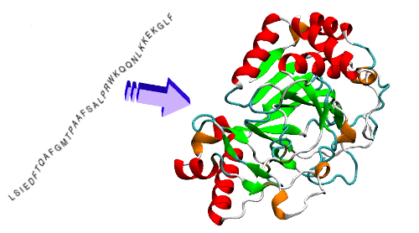
Why study Scramble Squares?

Slide 7
Why study Scramble Squares?
Scramble Squares
Protein Structures
4 image types
Tiles have binding sites
Tiles rotate through a fixed location
Adjacent edges must have complimentary images that match
Avoid impossible layouts
4 base pairs in DNA
Proteins have binding sites
Amino acids rotate through bond angles
Hydrophobic and hydrophilic sections must align
Avoid high energy conformations
We cannot solve the protein folding problem using brute force methods!

Slide 8
Scramble Squares
Assume you and I have the same puzzle but we are sitting in two physically different locations
Write down in your own words:
What analysis have you done to better understand the problem?
How can we encode the order and orientation of each puzzle piece, so you can tell me your solution over the phone?
What process I should follow to solve the Scramble Squares puzzle on my own?

Slide 9
Solve It Like A Scientist!
Don’t just look at the pieces – see them
What research questions can you pose about your puzzle set?
What types of analysis of each piece could help guide you to a solution?
What makes one set of Scramble Squares harder (or easier) to solve than another?

Slide 10
Research Questions
How many total squares (tiles) are there in your deck?
How many total distinct puppy breeds are represented in your deck?
How many image halves (head or body) can be shown on one tile?

Slide 11
Research Questions
How many times does each half image, head vs. body, appear in your deck, for each breed?

Slide 12
Research Questions
Which tile has the most number of head images?

Slide 13
Research Questions
Which tile has the most number of body images?
Once you answered question #5, you already
had the answer for question #6 – why?

Slide 14
Research Questions
Which breed has the highest number of complete (both head and body) images?

Slide 15
Research Questions
Which breed has the largest disparity (difference) between the numbers of head images vs. body images throughout your entire deck?

Slide 16
Research Questions
How many binding sites must be matched by the tile at the center of a valid 3 x 3 matrix?
How many binding sites must be matched by the tiles at the corners of a valid 3 x 3 matrix?
How many ways can a tile be rotated to present alternative binding sites to its neighboring tiles?
How many distinct positions are there in a 3 x 3 matrix?
What position #’s only need to match three binding sites in a valid solution?

Slide 17
Research Questions
With 9 tiles and 9 possible positions to place each tile, how many distinct ways can you lay them out into a 3 x 3 matrix?
How many distinct ways can all 9 tiles be spun through each of the 4 possible rotations?
How many possible layouts are there in total (valid or invalid)?

Slide 18
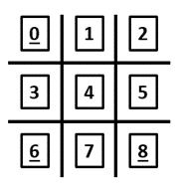
Encoding Tile Id and Position #
Every tile has an Id (0 – 8)
Every position has a # (0 – 8)
A “position” is a pointer to the tile that occupies that location on the board (or is null if that location is empty)
Each tile has a “Placed” Boolean (True or False) flag to indicate if it has already been successfully placed on the board

Slide 19
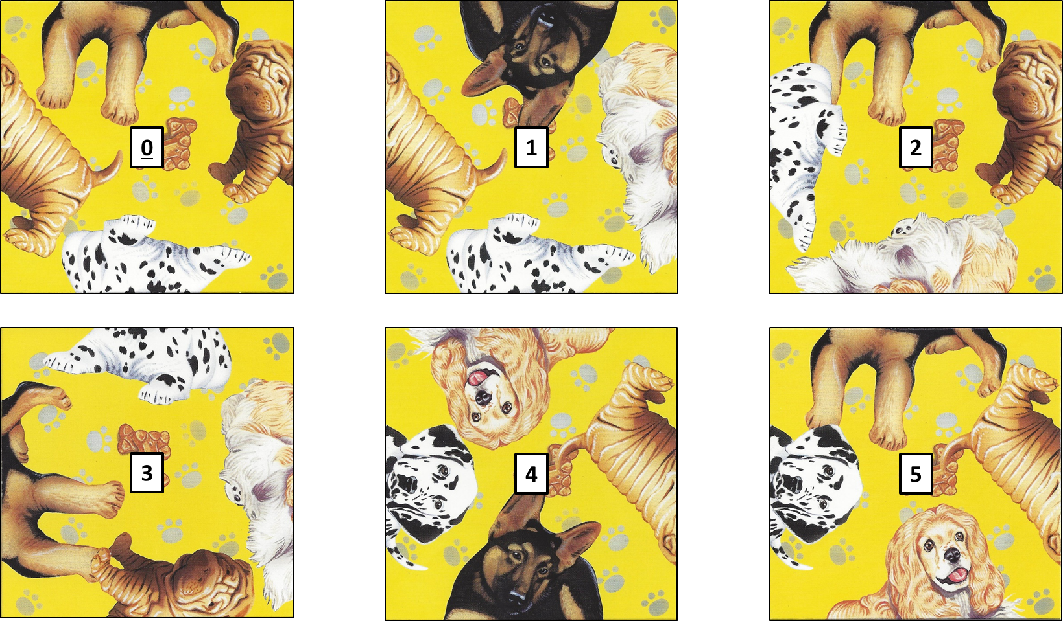
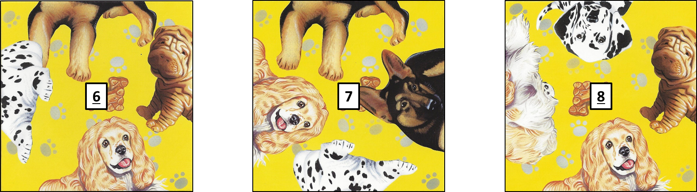
Initial State Assignment is Arbitrary
I randomly picked each tile in whatever orientation, and then put an Id number on it
Though totally arbitrary, this initial state encoding must remain consistent and used by everyone to verify the solutions

Slide 20
Encoding Bindings and Rotations
Each tile has 4 binding sites that each contain a half image value
Bindings sites are numbered 0 – 3 clockwise from North
Quarter turn counter-clockwise rotations are numbered 0 – 3
R 0 means that this tile is not rotated
0
North
3
West
1
East
Rotation
2
South

Slide 21
Encoding Bindings and Rotations
0
North
0
East
3
West
R 0
1
East
3
North
R 1
1
South
2
South
2
West
0
South
0
West
3
East
R 2
1
West
3
South
R 3
1
North
2
North
2
East

Slide 22
A Position Points To A Tile If Placed
0
1
2
Position #
Tile Id
3
4
5
6
7
8

Slide 23
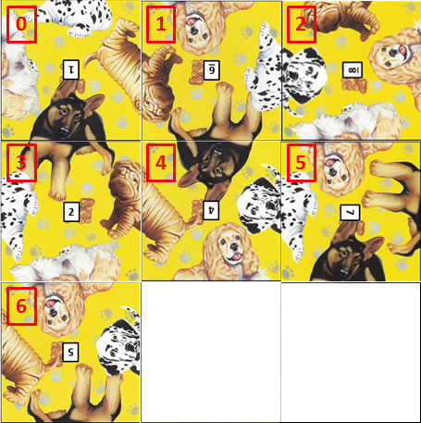
A Position is NULL if No Tile is Placed
7
8
NULL
NULL

Slide 24
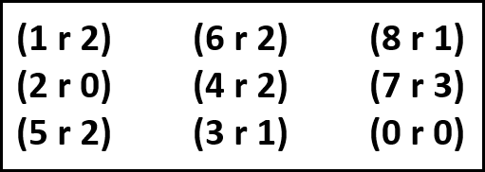
A Solution Written in Matrix Form
0
1
2
3
4
5
6
7
8

Slide 25


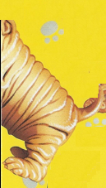





Encoding Half Images

Slide 26


Encoding Half Images ^{(Base 10)}
Complimentary
Sums
(0)
+
(1)
= 1
(2)
+
(3)
= 5
(4)
+
(5)
= 9
(6)
+
(7)
= 13

Slide 27
Encoding Half Images ^{(Base 10)}
(2)
+
(3)
= 5
(4)
+
(1)
= 5
Invalid
match!
(0)
+
(5)
= 5
Invalid
match!

Slide 28
Encoding Half Images ^{(Powers of 2)}
Complimentary
Sums
(1)
+
(2)
= 3
Only valid matches can produce these four sums!
(4)
+
(8)
= 12
(16)
+
(32)
= 48
(64)
+
(128)
= 192

Slide 29
Encoding Half Images ^{(Powers of 2)}
Invalid
sum!
(1)
+
(32)
= 31
(4)
+
(8)
= 12
(4)
+
= 5
Invalid
sum!
(1)
By encoding each half image with an increasing power of 2,
valid complimentary image matches will have a sum of *ONLY*
3, 12, 48, or 192 between adjacent binding sites.

Slide 30
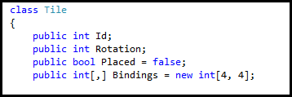
The “Tile” class
A Tile is a type of object
It has an “Id” between 0 - 8
We store its current rotation state (0 – 3)
We track if it is currently placed on the board
(true or false)
We store the power of 2 value of each half image, located at each of the four binding sites, for all four rotations.

Slide 31
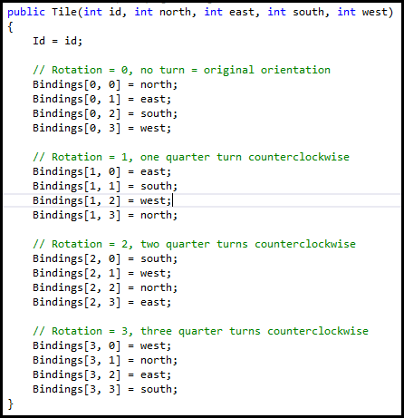
The Tile “constructor”
Given the Id and the half image binary values for each binding site, this function constructs a new Tile instance.
It also stores the half image values for each binding site (0 – 3)
for each possible rotation (0 – 3)

Slide 32
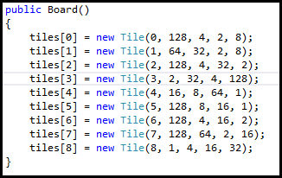
The Board “constructor”
Creates 9 tiles but does not assign them to a position yet.
Tile Id
Half image value at NORTH binding site per initial arbitrary state
Half image value at EAST binding site per initial arbitrary state
Half image value at SOUTH binding site per initial arbitrary state
Dalmatian Head = 1
Dalmatian Body = 2
Shar-Pei Head = 4
Shar-Pei Body = 8
Spaniel Head = 16
Spaniel Body = 32
Shepherd Head = 64
Shepherd Body = 128
Half image value at WEST binding site per initial arbitrary state

Slide 33
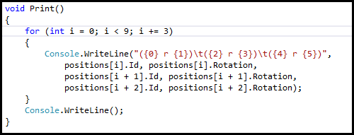

The Print() method
Shortcut for “i = i + 3”
Escape character for a TAB
Shorthand for a replacement parameter

Slide 34
IsMatch() method
Tile B is already placed on the board.
0
3
B
1
NOTE: These are the binding site numbers, not the half image power of 2 values stored at those binding sites.
2
0
Tile A is the one you are trying to place.
3
A
1
2

Slide 35
IsMatch() method
These are the half image power of 2 values stored in each binding site, for the current rotation of tiles A & B
2
128
B
32
Sum the NORTH binding (half image value) of Tile A and the SOUTH binding
(half image value) of Tile B
8
64
A
Checking the NORTH (0) binding site:
Tile A North binding = 64
Tile B South binding = 8
Since the sum (64 + 8 = 72) is not one of the allowed values {3, 12, 48, or 192},
Tile A cannot be placed in this position!
16
4
1

Slide 36
IsMatch() method
Checking EAST site (1) sum = 132 : No Good!
Checking SOUTH site (2)
sum = 3: Good!
64
2
64
16
A
4
128
B
32
16
A
4
1
8
1
Checking WEST site (3) sum = 48 : Good!
2
2
64
128
B
32
128
B
32
16
A
4
8
8
1

Slide 37
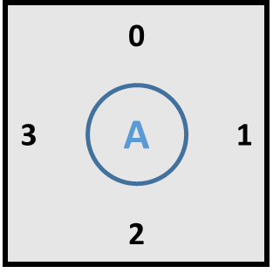
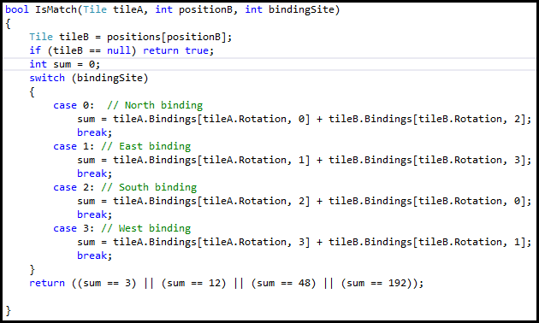
IsMatch() method

Slide 38
CanPlaceTile() method
0
0
0
3
0
1
3
1
1
3
2
1
To place a tile in position 0, the half image values at each of these two binding sites must have a valid sum!
2
2
2
0
0
0
3
3
1
3
4
1
3
5
1
2
2
2
0
0
0
3
6
1
3
7
1
3
8
1
2
2
2

Slide 39
CanPlaceTile() method
0
0
0
3
0
1
3
1
1
3
2
1
To place a tile in position 1, the half image values at each of these three binding sites must have a valid sum!
2
2
2
0
0
0
3
3
1
3
4
1
3
5
1
2
2
2
0
0
0
3
6
1
3
7
1
3
8
1
2
2
2

Slide 40
CanPlaceTile() method
0
0
0
3
0
1
3
1
1
3
2
1
To place a tile in position 2, the half image values at each of these two binding sites must have a valid sum!
2
2
2
0
0
0
3
3
1
3
4
1
3
5
1
2
2
2
0
0
0
3
6
1
3
7
1
3
8
1
2
2
2

Slide 41
CanPlaceTile() method
0
0
0
3
0
1
3
1
1
3
2
1
To place a tile in position 4, the half image values at each of these four binding sites must have a valid sum!
2
2
2
0
0
0
3
3
1
3
4
1
3
5
1
2
2
2
0
0
0
3
6
1
3
7
1
3
8
1
2
2
2

Slide 42
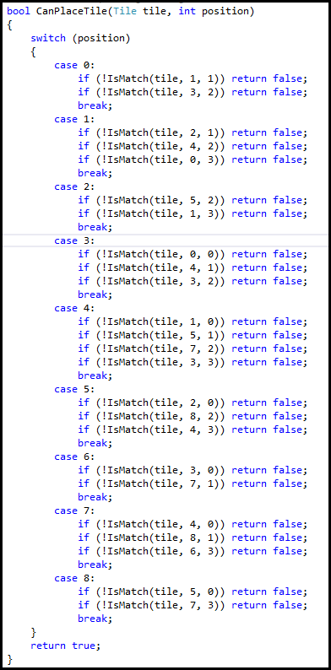
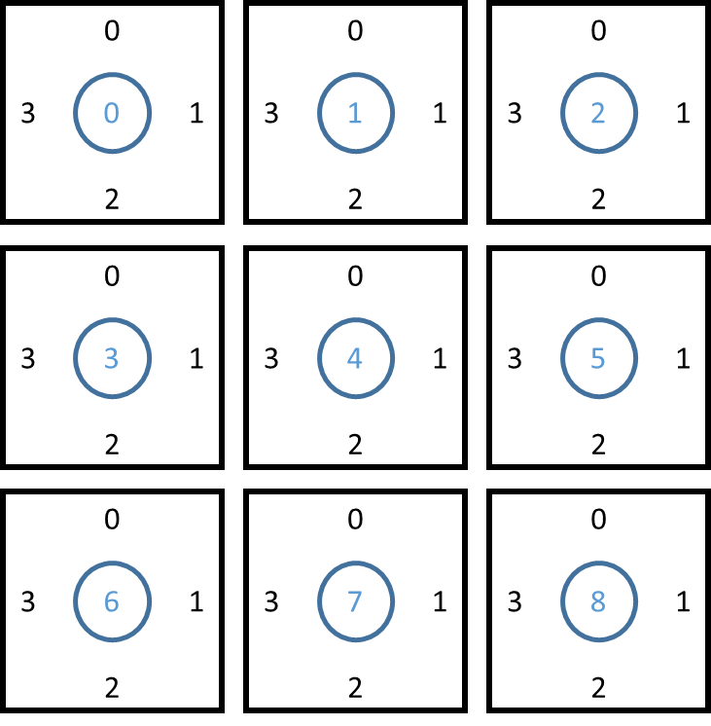
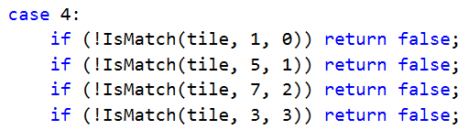
CanPlaceTile() method
Tile B
Tile A
Tile A position #
Tile B position #
Binding site # to check

Slide 43
Recursion
Recursion is when a function calls itself
Each invocation (instance) of the function has its own copy of its local variables
At the end of the function, the program returns to the place in the source code where it was previously called
Return values can be passed all the way back up the call stack to the very first calling function
A termination condition must exist to avoid an infinite loop and stack crash

Slide 44
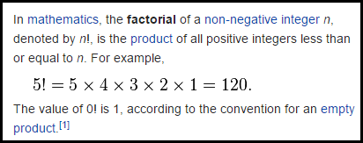
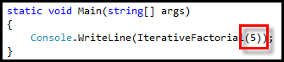
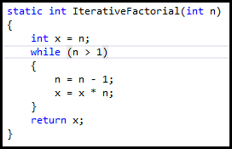
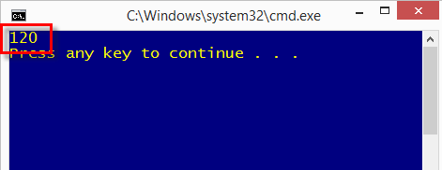
Iterative Factorial

Slide 45
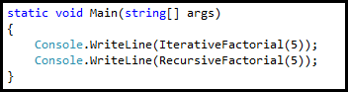
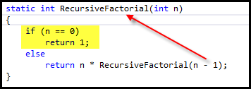
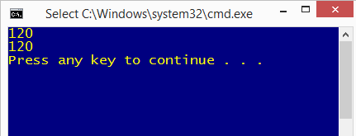
Recursive Factorial
N ! = N * (N – 1)!
where 0! = 1
Terminating Condition

Slide 46
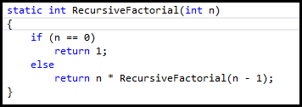
Recursive Factorial Call Stack
Recursive code is often a “natural” expression of the problem

Slide 47
Recursive Solve

Slide 48
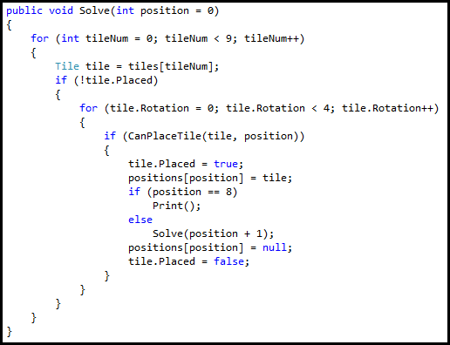
Recursive Solve

Slide 49
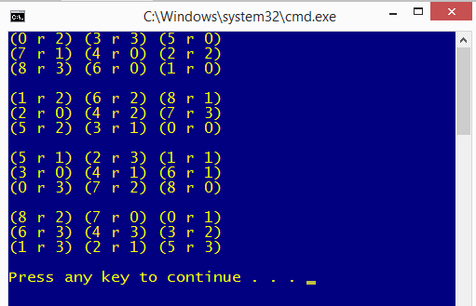
Recursive Solve
All four solutions found in 13 millionths of a second!

Slide 50
Solving Scramble Squares
The code recurses from position to position + 1, trying to place every tile in that position, in every rotation, that can fit the board so far.
The code does not waste time creating & checking tile permutations which cannot possibly work.
The terminating condition in the recursive Solve() function causes the code to “bottom out” and then “back track” up the call stack when no more tiles or rotations can be found that work in the current board layout.

Slide 51
Wouldn’t Brute Force Be Simpler?
When writing code to solve a problem, your first step should be to consider the brute force approach.
Enumerate every possible layout of tiles and rotations
If the current layout is valid then Print() the board
Keep looping until all permutations are tried
The code might be shorter, but the run time would be exponentially longer.
Polynomial run times might be tractable if you distribute the problem across thousands of computers
However exponential run times cannot currently be solved by brute force. (Maybe by quantum computers…)

Slide 52
Now you know…
Before diving into a problem, take the time to form meaningful research questions to help you analyze the situation systematically – see things as a scientist!
Binary encoding often provides a way to have unambiguous input and output
Recursion is a powerful concept that enables efficient search algorithms
You cannot conquer problems whose solution space grows exponentially (combinatorial explosion) via brute force alone – you need to find a smarter way to quickly rule out permutations that cannot possibly be valid

